Slide 1

802.11 Network Architecture

Slide 2
Chapter contents
The Basic Service Set
Locating a wireless LAN
Joining a wireless LAN
The Distribution System
Roaming
Power Management Features

Slide 3
Key concepts
Wireless LAN service sets
Locating a wireless LAN
Roaming
….how are wireless organized ??

Slide 4
Service sets
Basic service sets
Extended service sets
Independent service sets

Slide 5
IEEE 802 .11 Terminology
STA (Station)
Station (STA) Architecture:
Device that contains IEEE 802.11 conformant MAC and PHY interface to the wireless medium, but does not provide access to a distribution system
Most often end-stations are available in terminals (work-stations, laptops etc.)
Ethernet-like driver interface
  supports virtually all protocol stacks

Slide 6
IEEE 802 .11 Terminology
AP (Access Point)
Access-Point (AP) Architecture:
Device that contains IEEE 802.11 conformant MAC and PHY interface to the wireless medium, providing access to a distribution system for associated stations
Most often an infrastructure products that connect to wired backbone
STAs select an AP and “associate with it
APs :
- Support roaming
  Provide time synchronization (beaconing)
  Provide Power Management support

Slide 7
IEEE 802 .11 Terminology
Basic Service Set (BSS)
Basic Service Set (BSS): Infrastructure mode
A set of stations controlled by a single “Coordination Function” (=the logical function that determines when a station can transmit or receive)
Station-to-Station traffic is relayed by the Access Point
BSS

Slide 8
Infrastructure Basic Service Set
Involves an access point (AP) for all communication between clients
AP sets up communication and SSID
A single AP, it is referred to as a Basic Service Set (BSS)
More than one, an Extended Service Set (ESS)
Roaming is possible when using an ESS)

Slide 9
IEEE 802 .11 Terminology
Independent Basic Service Set (IBSS)
Independent Basic Service Set (IBSS): adhoc mode
A Basic Service Set (BSS) which forms a self-contained network in which no access to a Distribution System is available
A BSS without an Access-Point
Station-to-station traffic flows directly without any relay action
All stations in the cell will be able to receive frames transmitted by another station in the cell (filtering of traffic for subsequent processing is based on MAC address of the receiver)
IBSS

Slide 10
Independent Basic Service Set (IBSS): adhoc mode
Does not involve an access point (AP)
Client devices/computers connect directly
One device sets up communication and Service Set Identifier (SSID)
Often referred to as an Ad-Hoc
Limited security options
Beware of “Free Public Wi-Fi!”

Slide 11
IEEE 802 .11 Terminology
Extended Service Set (ESS) - Wired DS
Extended Service Set (ESS):
A set of one or more Basic Service Sets interconnected by a Distribution System (DS)
Traffic always flows via Access-Point
Distribution System (DS):
A system to interconnect a set of Basic Service Sets
  Integrated; A single Access-Point in a standalone network
  Wired; Using cable to interconnect the Access-Points
  Wireless; Using wireless to interconnect the Access-Points
BSS
Distribution
System
BSS

Slide 12
IEEE 802 .11 Terminology
Extended Service Set (ESS) - Wireless DS
Extended Service Set (ESS):
A set of one or more Basic Service Sets interconnected by a Distribution System (DS)
Traffic always flows via Access-Point
Distribution System (DS):
A system to interconnect a set of Basic Service Sets
  Integrated; A single Access-Point in a standalone network
  Wired; Using cable to interconnect the Access-Points
  Wireless; Using wireless to interconnect the Access-Points
BSS
Distribution
System
BSS

Slide 13
IEEE 802 .11 Terminology
SSID (Network name)
Service Set Identifier (SSID):
“Network name”
One network (ESS or IBSS) has one SSID
32 octets long string
Needed to separate one network from the other
Used during initial establishment of communication between STA and AP to allow STA to select the correct AP
Can be viewed as Security Provision in combination with so-called “Closed Option” (not providing the correct SSID means no access to the network)
BSSID = xx-xx-xx-xx-xx-xx
BSS
Distribution
System
BSS
SSID = ABCD
BSSID = yy-yy-yy-yy-yy-yy

Slide 14
IEEE 802 .11 Terminology
BSSID (Cell Identifier)
Basic Service Set Identifier (BSSID)
“cell identifier”
One BSS has one BSSID
6 octets long (MAC address format)
In ESS the value is the same as the MAC address of the radio in the AP
In IBSS the value of BSSID will be randomly generated, and with local-bit on
Used as filter for multi-cast traffic and for traffic from other networks (in IBSS networks)
Used during hand-over (roaming) to other AP, in identifying the “old” AP
BSSID = xx-xx-xx-xx-xx-xx
BSS
Distribution
System
BSS
SSID = ABCD
BSSID = yy-yy-yy-yy-yy-yy

Slide 15
Service Set Identifier (SSID)
Represents the wireless LAN to potential clients
May be broadcast but can be hidden for security purposes
SSID’s can be mapped to separate VLAN segments and subnets
Multiple SSID’s can be broadcast/configured on access points
In order to roam from one access point to another the SSID settings must match

Slide 16
Locating wireless LANS
Service identifiers (SSID)
  Name of wireless LANS
  2 to 32 characters
  Can be alphanumeric
  They are case sensitive
Beacon frames
  Management frames
  Transmitted from Aps to Stations
  Can be considered to be the “heart beat” of WLANS

Slide 17
Contents of a Beacon frame
Time stamp
  Contains time of AP clock
  Stations update local clock with timestamp value
  This synchronizes the AP and Station clocks
SSID
  May be displayed in beacon frame if broadcast of SSID is enabled.

Slide 18
Contents of a Beacon frame
Support Rates
  Data transfer rates that are supported ie 1,2,5.5 11Mbs
Parameter Sets
- indicates the Spread Spectrum technology systems being used FHSS or DSSS
Traffic Indicator Map(TIM)
- identifies which stations using power save mode have data frames buffered at the AP

Slide 19
Scanning
When an 802.11 client adapter comes online, it begins searching for networks to associate with.
Based on signal strength and other factors, the client tries to associate with the selected SSID.

Slide 20
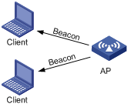
Scanning
Passive scanning
  Process of listening for beacons on each channel
  The beacons are sent by the AP(infrastructure mode or ad-hoc mode)
  The station then joins the BSS using the AP that sent beacon

Slide 21
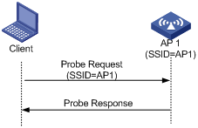
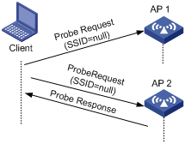
Scanning
Active scanning
  Wireless stations sends probe request frames
  Probe frames are sent by the station that wants to connect to WLAN
  Frame specifies SSID

Slide 22
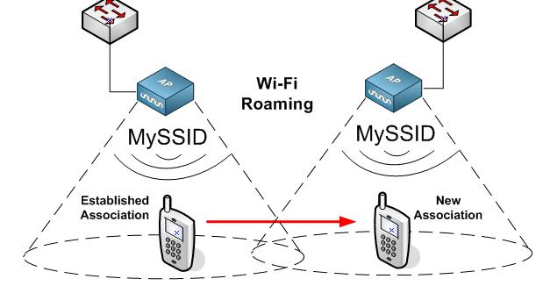
Roaming
The ability of wireless client to move seamlessly from one BSS to another without losing network connectivity

Slide 23
Authentication + Association
Authentication
  Verify the identity of the wireless client
  First step required to connect to WLAN
Association
  Wireless client allowed to transmit data through an access point

Slide 24
Authentication Request
802.11 standard specifies authentication mechanisms
– Open Systems Authentication
– Shared Key Authentication
– 802.1X Authentication

Slide 25
Association Request
Forming a logical connection between access point and client
– Client sends an association request frame
– Access point responds with a response frame

Slide 26
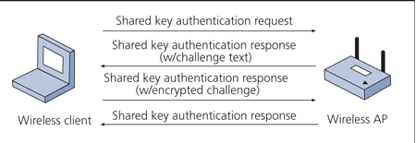
Shared Key Authentication

Slide 27
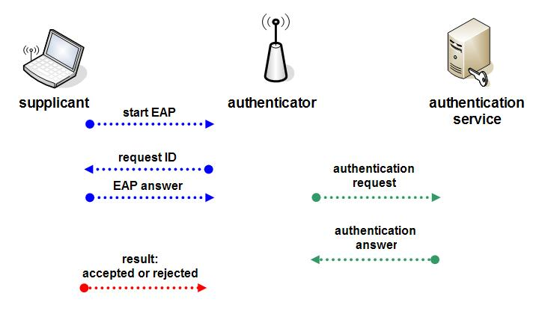
802.11x and EAP

Slide 28
Operational processes
Authentication
Process within an ESS to control access to the network
Stations need to identify themselves to other Access-Points prior to data traffic or association
Open System Authentication
  Uses null authentication algorithm
  Default
Shared Key Authentication
  Uses WEP/WPA/WPA2 privacy algorithm
  Optional

Slide 29
Operational processes
Association
Before a STA can access an ESS, “Association” has to be completed
Process within an ESS where an STA establishes a relationship with an AP
STA will scan the available channels in the 2.4 GHz band to select AP (with matching SSID) that has the best communications quality
  Active Scan (sending a “Probe request” on specific channels and assess response)
  Passive Scan (assessing communications quality from beacon message)
AP maintains list of associate stations in MAC FW
  Record station capability (data-rate)
  To allow inter-BSS relay
Station’s MAC address is also maintained in bridge learn table in the Access Point associated with the port it is located on

Slide 30
Operational processes
Starting an ESS
The infrastructure network is identified by its SSID (network name)
All APs have to be configured to use this SSID
On power up stations will issue Probe Requests and will locate the AP that they will associate with:
  “best” Access-Point with matching SSID
  “best” Access-Point if the “desired SSID” has been set to “ANY” or a blank (empty) string (known as the “broadcast SSID”

Slide 31
Operational processes
Starting an IBSS
Station configured for IBSS operation will:
  Scan the band (using Probe requests) using the SSID it was configured with
  Received Probe Responses that match the SSID contain indication about sender of the Probe Response:
    If sender is an AP, the station will associate to the AP
    If sender is another STA in IBSS mode, the station will join this IBSS, and will obtain the BSSID of the starter to be able to filter traffic (for network separation)
  When no Probe Responses are received with matching Network Name, Station will start the IBSS network:
    Set an BSSID (randomly generated, in MAC address format with local bit on)
    Start sending Beacons
All Stations in an IBSS network will participate in sending beacons.
  All stations start a random timer prior to the point in time when next Beacon is to be sent.
  First station whose random timer expires will send the next beacon

Slide 32
Power Management Features
IEEE specified two power management modes
  Active mode(continuous aware mode-CAM) provides no power conservation . AP can send frames to active mode stations at any time.
  Power saving mode(power save polling-PSP) stations alternate between dozing and awake depending on its need to transmit or receive . Behavior is different in both ad hoc and infrastructure mode

Slide 33
State machine
Unauthenticated and Unassociated
Authenticated and Unassociated
Authenticated and Associated

Slide 34
End

